Slide 1
GP Strategies INVESTOR Presentation
January 2017
MBI – GP Strategies Company Confidential
Notes:
Data Revised 1.5.15
Information Classification
Information classification is a critical part of GP Strategies data security. The following classifications should be applied to any document that is not classified as PUBLIC INFORMATION. For more information regarding information classification and handling, please visit the IT Security Center https://gpweb.gpstrategies.com/corp/its/Security/Security-Home.aspx
High Business Impact (HBI - GP Strategies Company Confidential)
This classification category MUST be assigned to information asset types where unauthorized disclosure could cause severe or catastrophic material loss to GP Strategies, the Information Asset Owner, or relying parties. These are not actual GP Strategies classifications but some illustrative examples of what could be classified as HBI by the Information Asset Owner:
• Authentication/authorization credentials and/or other information that can be used to directly or indirectly authenticate or authorize valuable transactions
• Information under strict regulatory handling requirements (e.g., Directive 95/46/EC, GLBA, PCI, HIPAA, and CA SB1386) and/or business secrets (e.g., unannounced financials, trade secrets)
• Source code, symbols, binaries, or specifications that could negatively impact GP Strategies competitive advantage or Intellectual Property rights
Moderate Business Impact (MBI - GP Strategies Company Confidential)
This classification category MUST be assigned to information asset types where unauthorized disclosure could cause serious material loss to GP Strategies, the Information Asset Owner, or relying parties. These are not actual GP Strategies classifications but some illustrative examples of what could be classified as MBI by the Information Asset Owner:
• Unreleased training materials and network infrastructure configurations and/or designs
• Source code or binaries that, if reverse engineered or cloned, could result in serious material impact to the quality and/or integrity of GP Strategies products or brand.
Low Business Impact (LBI - GP Strategies Company Confidential)
This classification category MUST be assigned to information asset types where unauthorized disclosure could result in none to limited material loss to GP Strategies, the Information Asset Owner, or relying parties. These are not actual GP Strategies classifications but some illustrative examples of what could be classified as LBI by the Information Asset Owner:
• Companywide announcements and information that all employees, contractors, and those under NDA have been approved to read
• Source code for publicly released training materials.
Public Information:
This classification category is assigned to information intended for public use that, when used as intended, would have no adverse effect on the operations, assets, or reputation of GP Strategies, or the GP Strategies' obligations concerning information privacy. Public information requires no labeling.

Slide 2
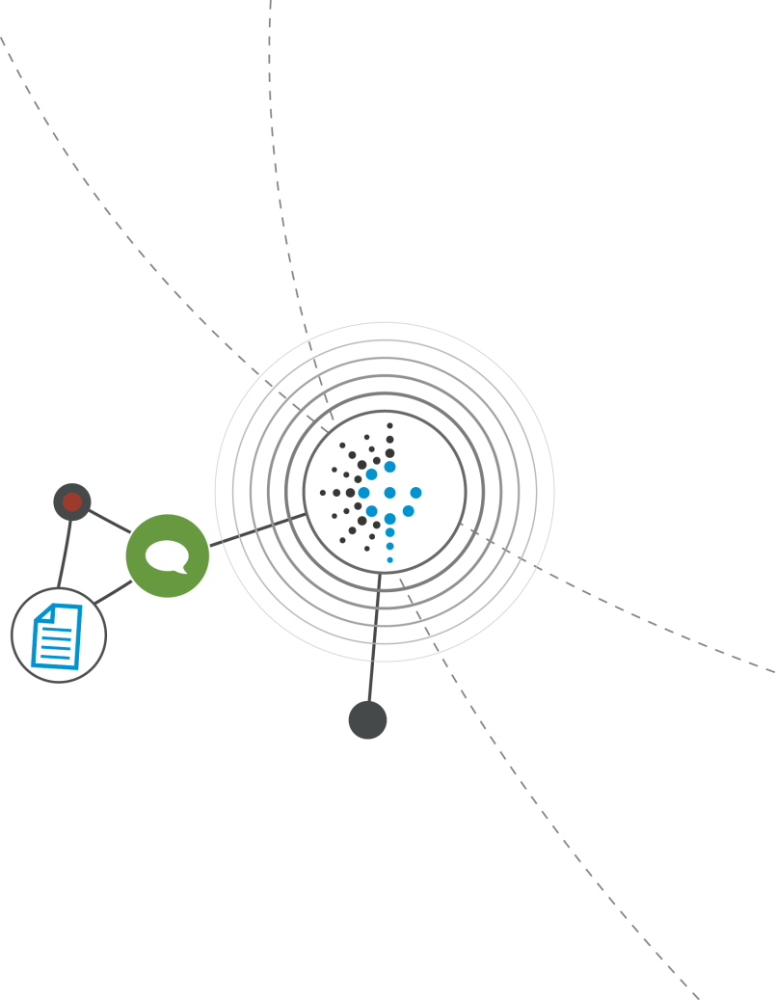
Safe Harbor
This presentation has been prepared by GP Strategies. This presentation does not constitute
an offer to any person or to the general public to acquire securities issued in any jurisdiction or
an inducement to enter into investment activity.
The information contained in this presentation has not been independently verified. No representation or warranty expressed or implied is made as to, and no reliance should be placed on, the fairness, accuracy, completeness or correctness of the information or the opinions contained herein. The Company or any of its respective affiliates shall not have any liability whatsoever (in negligence or otherwise) for any loss howsoever arising from any use of this presentation or its contents or otherwise arising in connection with the presentation.
This presentation is only for persons having professional experience in matters relating to investments and must not be acted or relied on by persons who are not such persons.
This presentation includes ‘forward-looking statements’. These statements contain the words “anticipate”, “believe”, “intend”, “estimate”, “expect” and words of similar meaning. All statements other than statements of historical facts included in this presentation, including, without limitation, those regarding the Company’s financial position, business strategy, plans and objectives of management for future operations (including development plans and objectives relating to the Company’s products and services) are forward-looking statements. Such forward-looking statements involve known and unknown risks, uncertainties and other important factors that could cause the actual results, performance or achievements of the Company to be materially different from future results, performance or achievements expressed or implied by such forward-looking statements. Such forward-looking statements are based on numerous assumptions regarding the Company’s present and future business strategies and the environment in which the Company will operate in the future. These forward-looking statements speak only as at the date of this presentation. The Company expressly disclaims any obligation or undertaking to disseminate any updates or revisions to any forward-looking statements contained herein to reflect any change in the Company’s expectations with regard thereto or any change in events, conditions or circumstances on which any such statement is based.
Past performance cannot be relied upon as a guide to future performance.

Slide 3


INVESTMENT DATA
Exchange: NYSE (GPX)
Business: Custom Training & Performance Improvement
Web Address: www.gpstrategies.com
Headquarters: Columbia, Maryland USA
Common Shares Outstanding – Fully Diluted 16.8 million
Market Capitalization @ $28.00 per share $470 million
Revenue – TrailingTwelve Months Ended 09/30/2016 $490 million
EBITDA – Trailing Twelve Months 09/30/2016, Excluding Severance $39 million
Corporate Contacts:
Scott Greenberg, CEO 443-367-9640
Sharon Esposito-Mayer, CFO 443-367-9636
Investor Relations:
Ann Blank, Director, Investor Relations 443-367-9925

Slide 4




MISSION
VISION
VALUES
VISION
GP Strategies
VISION
VALUES
VALUES
MISSION
GP Strategies is a leading custom TRAINING and PERFORMANCE improvement company.
Our VISION is a world where business excellence makes possibilities achievable.
Our MISSION is to enable people and businesses to perform at their highest potential.

Slide 5

GP Strategies AWARDS
What INDUSTRY says about us:
What CLIENTS say about us:
        Engineering New Record
2015 ENR Top 500 Design Firms
        Elearning! Magazine
2015 Winner for Best Outsource Learning Services provider
2014 Excellence for Best Managed Learning Services provider
        Training Industry, Inc.
        2016 Top 20 Sales Training Company (9th Consecutive Year)
        2016 Top 20 Leadership Training Company (4th Consecutive Year)
        2015 Top 20 IT Training Company (8th Consecutive Year)
        2015 Top 20 Gamification Company (2nd Consecutive Year)
        2015 Top 20 Learning Portal Company (6th Consecutive Year)
        2015 Top 20 Workforce Development Company (4th Consecutive Year)
        2015 Top 20 Content Development Company (5th Consecutive Year)
        2015 Top 20 Training Outsourcing Company (12th Consecutive Year)
        Brandon Hall Group
        2015 Gold | Best Custom Content
        Gold | Best Sales Training Program
        Gold | Best Advance in Benefits Strategy and Administration
        Silver | Best Advance in Custom Content
        Silver | Best Learning Team
        Bronze | Best Advance in Compliance Training
        Bronze | Best Unique or Innovative Leadership Development Program
        Bronze | Best New Hire Onboarding Program
        Bronze | Best Advance in Succession and Career Management
        Leadership Excellence
        2014 Leadership Partners and Providers
        Large Consulting Groups (50+employees); Ranked #3
        (7th Consecutive Year)
        Leadership Excellence
        2007-2015 Leadership 500
        Deere & Company
        2015 “Partner-Level Supplier” Recognition (6th Consecutive Year)
Notes:
http://www.gpstrategies.com/aboutUs/awards.aspx
We believe helping you improve your organizational performance is reward in itself. However, we are especially grateful when our accomplishments are also acknowledged by our customers and the learning industry. The following awards are representative of the types of awards GP Strategies wins year after year. In fact, some of the awards listed are ones we've won for as many as 10 consecutive years in a row!

Slide 6

Our LOCATIONS
  AMERICAS
  EMEA
  APAC
  Argentina
  Brazil
  Canada
  Colombia
  Mexico
  United States
  Denmark
  Egypt *
  Finland *
  France
  Germany
  Hungary *
  Netherlands
  Poland
  South Africa
  Turkey
  United Arab Emirates
  United Kingdom
  Australia*
  Hong Kong
  India
  Japan
  Mainland China
  Malaysia
  Philippines
  Singapore
  South Korea
  Taiwan
* Registered Entity – Office Location Pending
Notes:
Location data as of 12/17/2014
Egypt, Finland and Hungary are registered entities where we currently do NOT have Office Space or Brick & Mortar.
We operate in over 47 countries….we have locations in 27 countries.
Office Locations
Argentina
Brazil
Canada
China
Colombia
Denmark
Egypt*
Finland*
France
Germany
Hong Kong
Hungary*
India
Japan
Malaysia
Mexico
Netherlands
Philippines
Poland
Singapore
South Africa
South Korea
Taiwan
Turkey
United Arab Emirates
United Kingdom
United States
* Registered Entity –
Office Location Pending
Where We Operate
Argentina
Australia
Austria
Bahrain
Belgium
Brazil
Canada
Chile
China
Colombia
Denmark
Dominican Republic
Egypt
Finland
France
Germany
Ghana
Hong Kong
Hungary
India
Ireland
Japan
Malaysia
Maldives
Mexico
Netherlands
Nigeria
Norway
Philippines
Poland
Puerto Rico
Qatar
Russia
Saudi Arabia
Singapore
South Africa
South Korea
Spain
Oman
Sweden
Switzerland
Taiwan
Turkey
United Arab Emirates
United Kingdom
United States
Vietnam

Slide 7









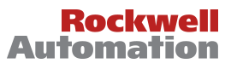




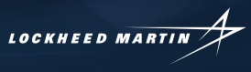
Organization Growth — CUSTOMERS
1
x
152 Fortune 500 Customers
119 Global 500 List Customers
7
7
Notes:
Note: This is an optional slide and can be removed.

Slide 8

GP Strategies COMPETITIVE STRENGTHS
Competitive Strengths:
  Global Delivery and Single-Source Custom Training Solutions Provider
  Outstanding Reputation in the Industry
  Diverse and Stable Client Base
  Scalable Technology Platform
  Legacy Technical Expertise
  Business Model Supports Visibility of Revenue
  Highly Qualified and Dedicated Employees and Tenured Management
Industry Drivers:
  Outsourcing - companies focusing on core competencies and reducing costs
  Cost effectiveness of E-Learning solutions
  New products, changing technology and regulations
  Global expansion and alignment

Slide 9

Training is a LARGE and FRAGMENTED MARKET
Total training industry is over $100 billion
Currently, in excess of 60% of training is performed by in-house departments, but the trend to outsource increased in 2015

Slide 10
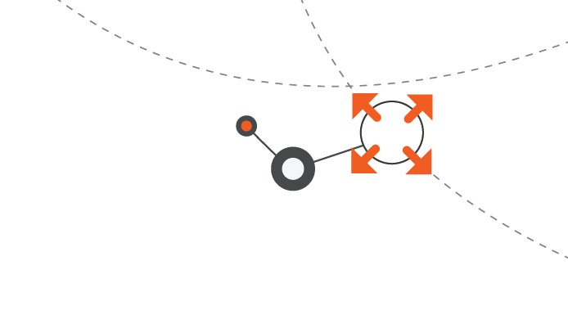
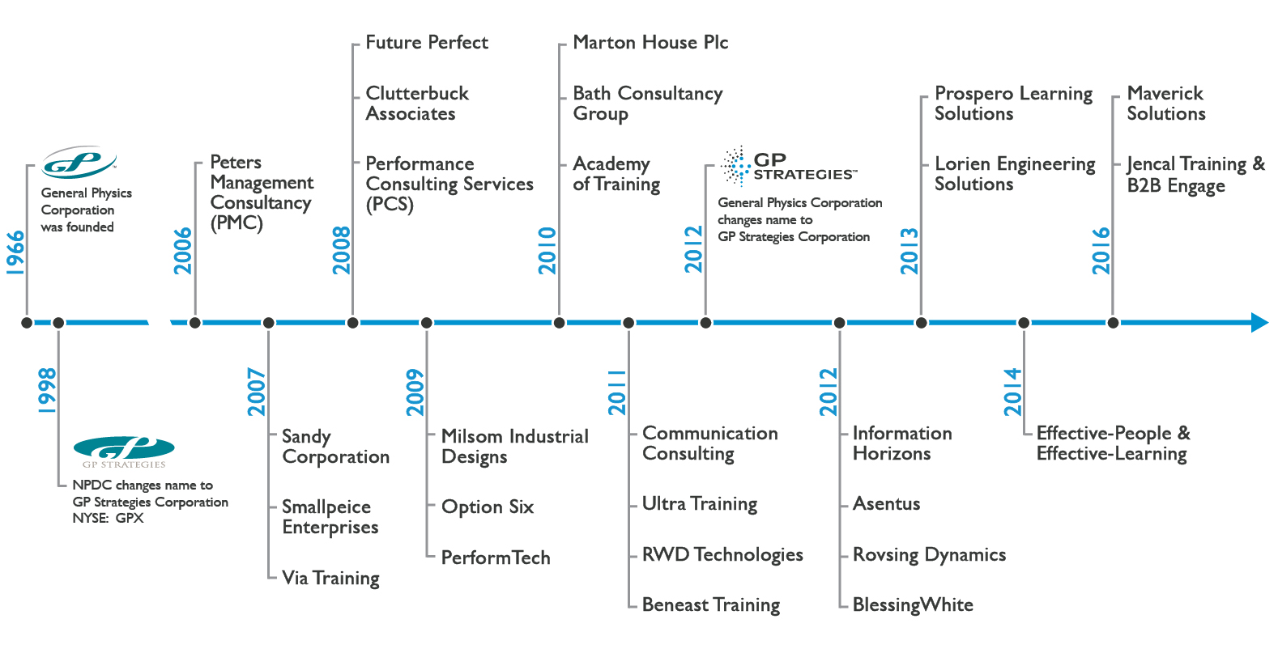
We are focused on expanding our SERVICES and PRODUCT LINES
Notes:
http://investors.gpstrategies.com/hist.aspx

Slide 11
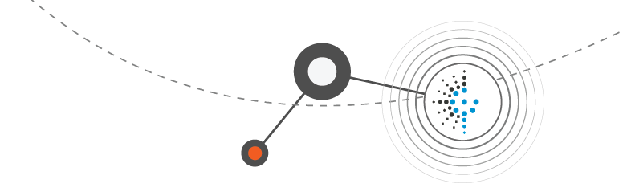
GP Strategies REVENUE BY SEGMENT
Product Sales Training
Marketing
Technical & Engineering
Energy Products
Government Services
Organization & Leadership Development
Sales Solutions
Managed Global Learning Services
Content Design & Development

Slide 12




Automotive Product Sales Training
SANDY TRAINING & MARKETING
Automotive dealership sales training
35+ years experience – Sandy branding
Predominant player at General Motors (largest customer) North America
Automotive solutions offering includes technical training, publications, and product launch services
Received major contract renewals in 2015
Large publication award in 2015
Expansion into new customers in 2016 and using global platform
5 customers in top 20

Slide 13
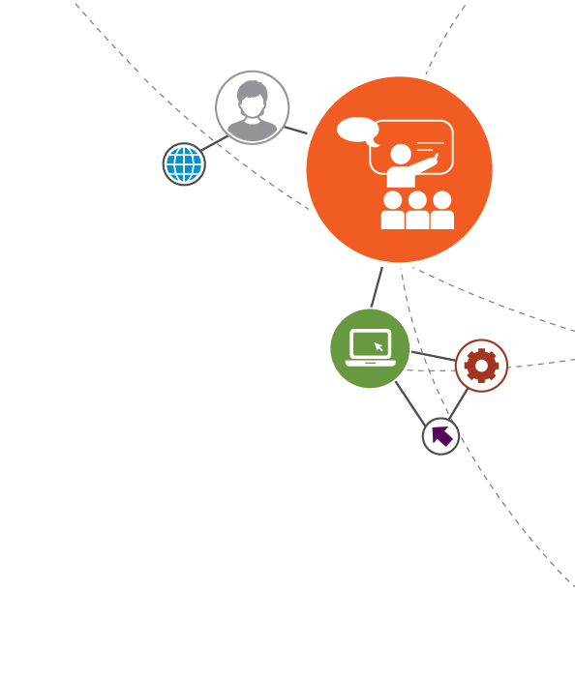
Managed Global Learning Services
Content Design & Development
Skills Funding
Human Capital
GP Strategies LEARNING SOLUTIONS
Managed Global Learning Services
  Training Administration
  Instructor Resource Management
  Vendor Management
  Tuition Program Management
Custom Content Development
  Instructor Led
  Elearning Learning
  Mobile Training
  Blended Learning
Skills Funding Agency
Human Capital Training
  Success Factors
Notes:
Our Managed Learning Services include:
Training Design and Development
Training Delivery
Curriculum Management
Training Administration and Logistics
Instructor Resource Management
Vendor Management
24/7 Call Center Services
Tuition Program Management

Slide 14
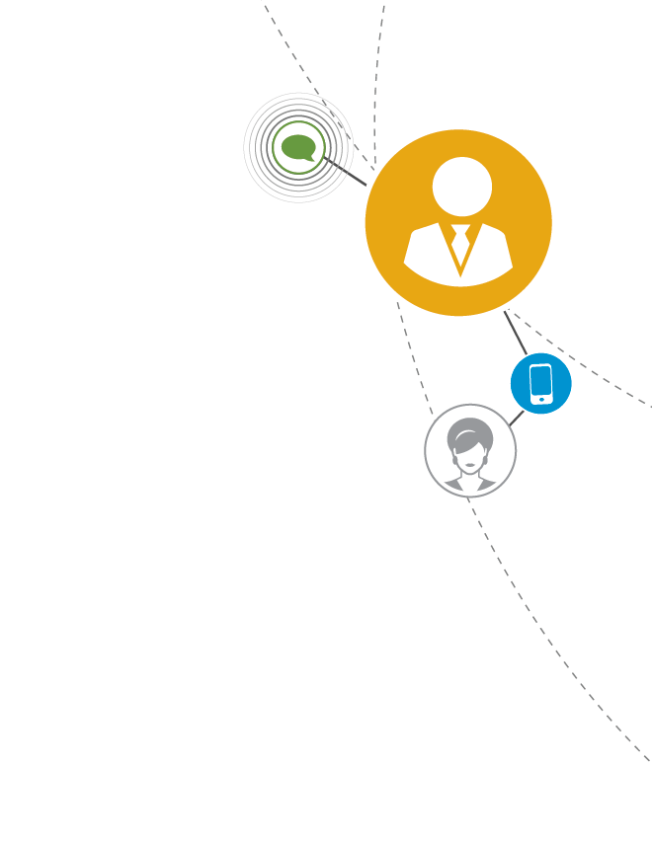
Organization & Leadership Development
GP Strategies
PERFORMANCE READINESS SOLUTIONS
SERVICES
Sales Solutions
ERP Solutions
Organization Leadership
Executive Leadership Development Services
Coaching (Mentoring)
Organizational Change and Transition Services
Platform Adoption Solutions
Customer Loyalty
Notes:
Our Organizational & Leadership Development Services include:
Executive Development Services
Leadership Development
Employee Engagement Services
Coaching
Mentoring
Talent-Focused Development
Organizational Change and Transition Services
Global, Virtual and Matrix Team Development
Professional Development and Managerial Skills Training

Slide 15
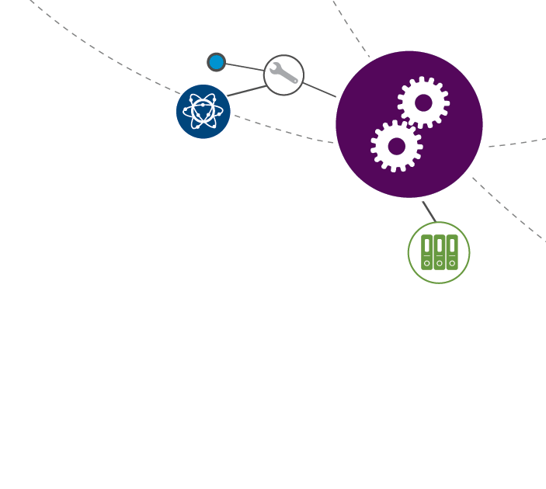
Technical & Engineering
GP Strategies
PROFESSIONAL & TECHNICAL SERVICES
Energy, Oil & Gas
Technical & Engineering
SERVICES
SERVICES
Energy, Oil & Gas
  Power Plant Performance Consulting and Operator Training
  Design/Build/Maintenance of LNG, LCNG and Hydrogen Fueling
  EtaPRO™ and GPiLearn⁺™
Technical and Engineering
  Government
  Technical Documentation
  Maintenance and Reliability Training and Tactics
  Engineering Design/Construction Management
  Process Safety, Risk Management and Compliance Solutions
Notes:
Technical & Engineering Services include:
Engineering Design/Construction Management
Logistic Support Analysis
Technical Documentation Development
Design of Repair and Overhaul Programs
Maintenance and Reliability Training and Tactics
Contract Management and Procurement
Engineering Inspection
Non-Destructive Testing
Electrical Design
Process Safety, Risk Management and Compliance Solutions
Mechanical Integrity
Construction Safety Solutions
Condition and Performance Monitoring of Plant Equipment with EtaPRO™
Environmental Services Including Waste to Energy, Alternative Energy, Waste Recycling and Carbon Reduction Programs
Homeland Security, Health Preparedness and Emergency Response
Original Equipment Manufacturing (OEM) and Dealership Sales, Service and Parts Operations
Technical and Leadership Training
Interactive Video Tele-Training
Recruitment

Slide 16


Strong FINANCIAL POSITION
Strong incremental operating margins
Variable cost structure
Strong cash flow
$65 million credit facility
Recurring client base
Backlog visibility

Slide 17
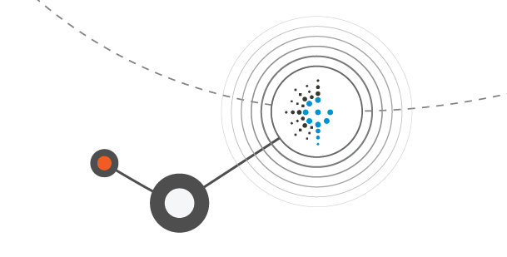
GP Strategies REVENUE
$501.9
$490.3
$436.7
$401.6
$363.8
$363.3

Slide 18
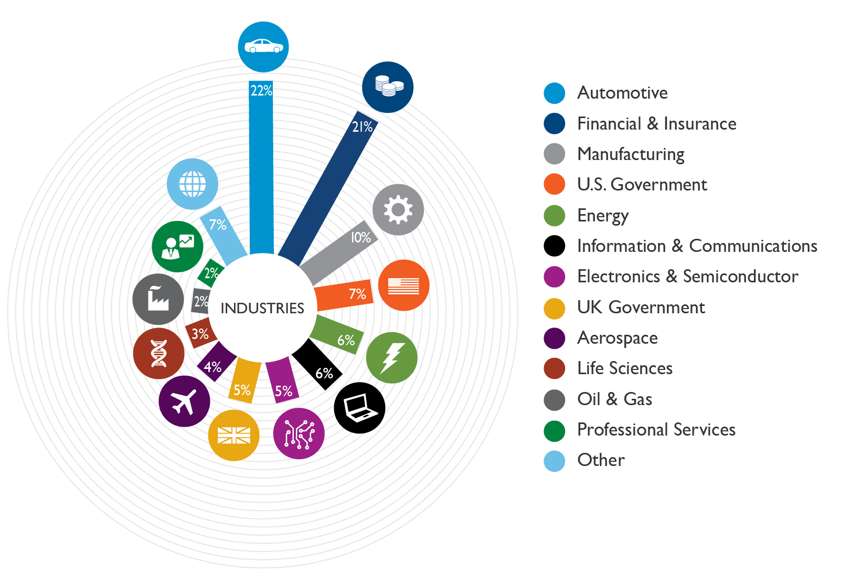
Serving a Diverse CLIENT BASE
Over 50 years of
SEASONED
INSIGHTS
Notes:
Industries Served Data from Q2 2016
Over the years, GP Strategies has had the privilege of serving organizations of all types, sizes and geographic footprints. As a result, our subject matter experts are continually on top of the industry trends, regulations and forecasts that affect your business. You can count on us for seasoned insights across a broad range of industries, including:
Aerospace
Automotive and Marine
Brewing
Electronics and Semiconductor
Energy, Including Alternative Fuels, Fossil Fuels, Nuclear, and Oil and Gas
Engineering, Procurement and Construction (EPC)
Financial
Food and Beverage
Government
Heavy Industry
Heritage Sector
Information Technology
Life Sciences
Manufacturing
Marketing and Retail
Metals
Non-Profit
Original Equipment Manufacturing (OEM)
Pipeline
Process
Sales, Both Direct and Retail
Waste

Slide 19
GP Strategies EBITDA
*Inclusive of Currency Losses, Restructuring & Contingent Consideration totaling $4.0M in 2015.
**Inclusive of severance of $0.5M in 2016.

Slide 20
GP Strategies BACKLOG
*Includes approximately $34M for oil and gas client to be performed over 5 years.

Slide 21
GP Strategies BALANCE SHEET

Slide 22

POISED for SUCCESS
Recognized leader in a large training market
Blue chip customers in multiple markets
Clear growth strategy
Strong financial position
Successful acquisition strategy in highly fragmented markets

Slide 23





Comments/Questions

